Slide 1
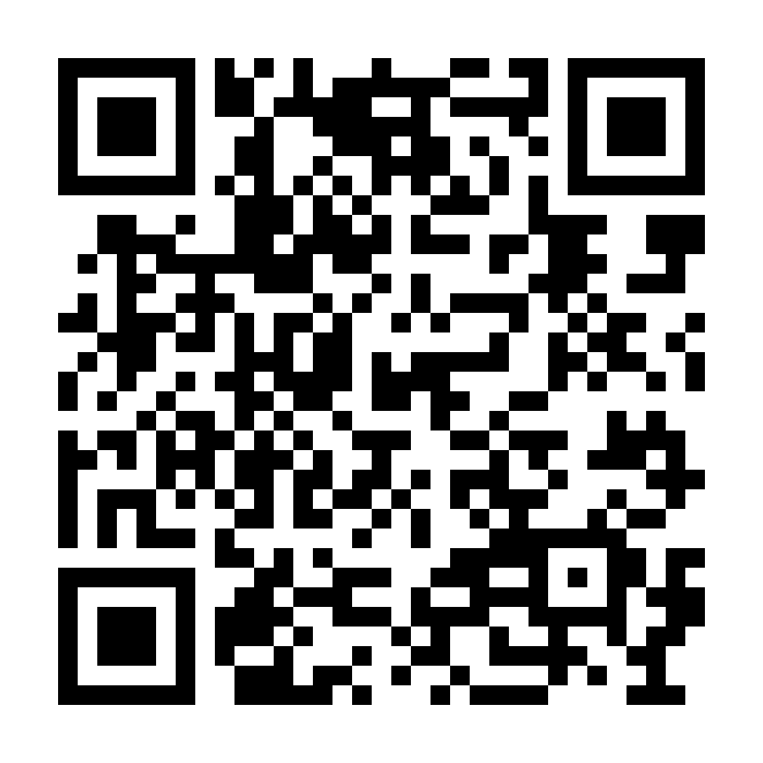
LEBANON CRISIS APPEAL
Communities are being devastated by conflict and economic instability.
Please help provide families with food, water, and medical care.
caritas.org.au/lebanondonate
1800 024 413
DONATE NOW
Photo: Caritas Lebanon

